Slide 1
PUBLIC ART SYNTHESIS
With some insights on ways of representation

Slide 2
Public Art Synthesis
The best public art connects us with the city
Public art makes us dissent our city as well
It intervenes with our day-to-day and even question it.
It is a process
It is a product
It is a participation

Slide 3
Artist is creating a voice in the community, not his own voice.

Slide 5
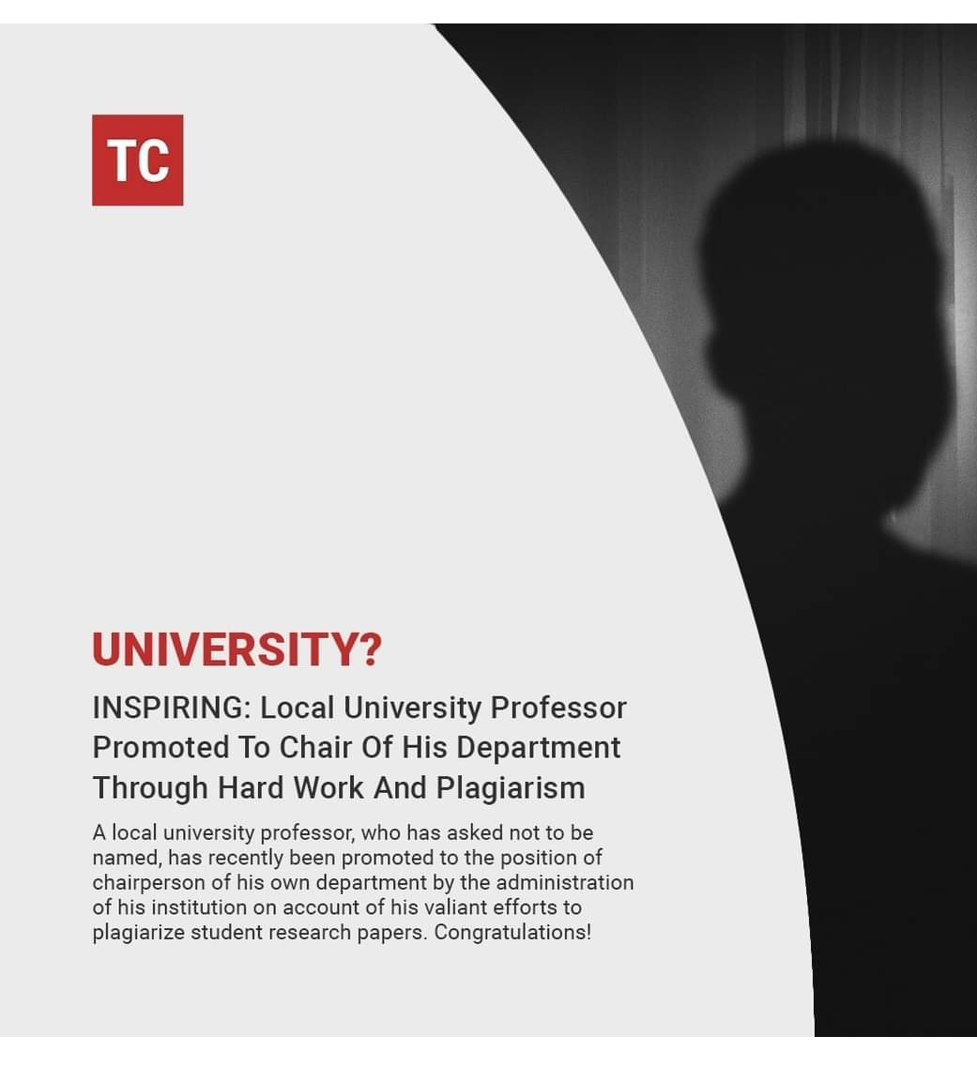

Slide 17
The following works use abstraction, distortion and surrealism as an inspiration and means of representation

Slide 24
We can use public art to activate a place, create social action opportunities and to vitalize commerce

Slide 25
Public art has to navigate legal concerns and must face disapproval or displeasure

Slide 26
Activity: Create a one-liner tag line, motto or clever line for a commercial ad or information drive using a surrealism image from the internet as an inspiration. You can invent a name of the company.
Avoid cliché’s such as “save the birds”

Slide 27
Examples
Cloudy vision? It’s time for a clearer eyesight with Eye’s the Limit Eyewear.

Slide 28
Don’t let time melt away with Picktime appointment scheduler!

Slide 29
Your vessel is not bottomless. So as your Earth.

Slide 30
The key to freedom is to carry it with you.

